Slide 1


UltraDepth: Exposing High-Resolution Texture from Depth Cameras
Zhiyuan Xie¹, Xiaomin Ouyang¹, Xiaoming Liu², and Guoliang Xing¹
¹The Chinese University of Hong Kong,
²Michigan State University
Notes:
Hi everyone, I’m Zhiyuan Xie. This is a joint work with Xiaomin Ouyang, Prof.Xiaoming Liu, and my advisor Prof.Guoliang Xing.

Slide 2
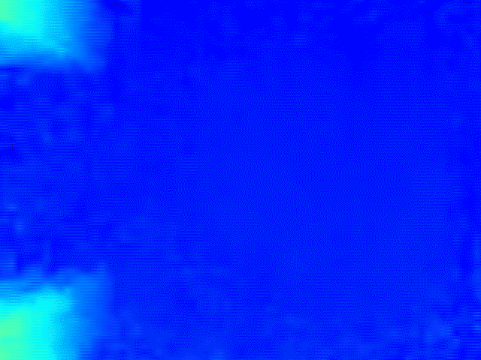
ToF Depth Camera: Background
USD
12.83
Bn
USD
2.93
Bn
Privacy-sensitive applications
2021
2029
Market Size
Notes:
Recently, the Time-of-Flight or ToF depth camera has attracted significant attention in the research community as well as in the industry. The ToF cameras are increasingly planted in lots of off-the-shelf devices/products. And the market size of ToF depth cameras is expected to double in five years.
The ToF camera is used to measure the distance between the camera and objects in the scene. However, this kind of depth map lacks a lot of texture. Therefore, as an alternative to the RGB camera, the ToF depth camera has enabled a wide range of privacy-sensitive applications that need to conceal the information while requiring some details, such as people counting & surveillance.
(ToF technology has enabled a new class / a wide range of privacy-sensitive applications that need to conceal the information
In many privacy-sensitive applications while requiring more details, alternative to RGB cameras.
ToF cameras can be used to replace RGB cameras)

Slide 3
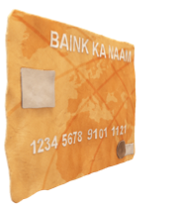

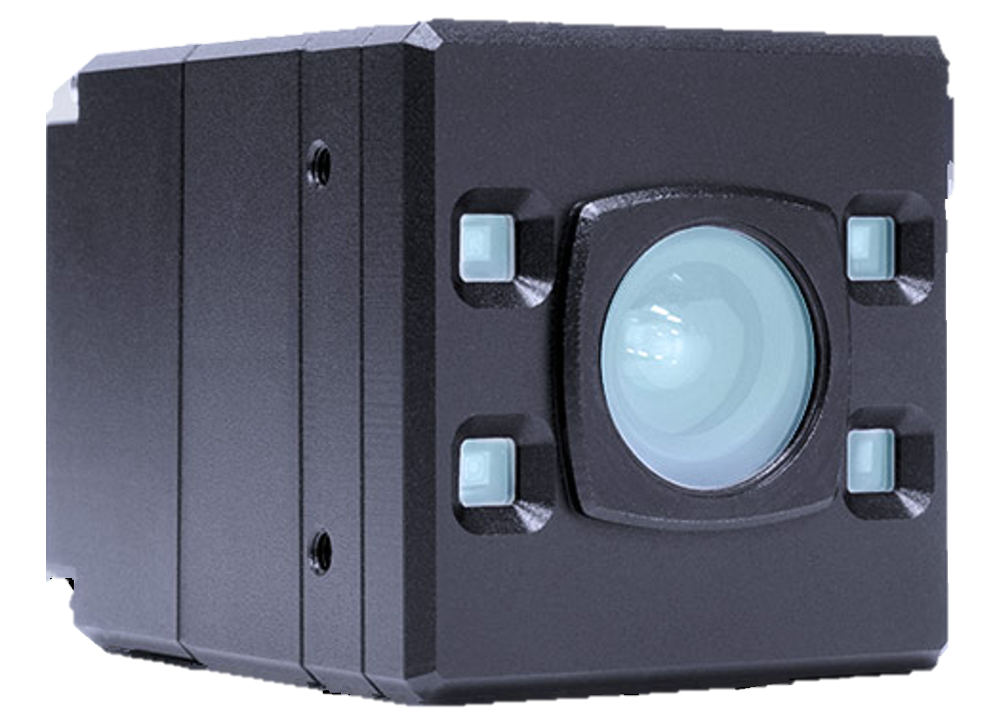

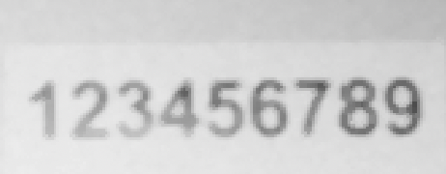
UltraDepth: Can we extract texture from depth maps?
Normal depth
Increase contrast
Distorting IR source
Our goal: Increase the contrast to expose texture from depth maps.
Our idea: Introducing distorting IR source.
Notes:
So we are wondering can we extract more details or texture from depth maps?
This is a normal depth map capturing a series of numbers, we can hardly recognize any texture on this map, and the distance measurement of a row in the depth map is shown on the right hand side. Basically, in order to show the texture, we need to increase the contrast of different distance measurement, so that the details of the content can be somehow amplified. Just like this figure shows. And then we are able to extract more details of the objects, this basically is the texture we are talking about.
To achieve this, we consider to use an additional distorting IR source since the distance measurement is obtained by calculating the time-of-flight of IR light.
(讲Key idea的时候，要想把它转换成什么问题, 我们的目标是从distance measurement里extract texture information，给一个原理性的东西。
Our goal is to increase the resolution / contrast of different distance measurement, so that we can extract.
给一个原理性的一句话, 把最关键的原理总结成一句话讲出来, 不要上来就讲distorting IR
Basically, in order to show the texture, we need to increase the contrast of distance measurements. So that the texture can be shown, / the details of the content can be somehow amplified.
去掉distorting IR source，改变展示顺序：顺时针旋转
Emits the IR, receive the IR, measure the time of flight.
If we could increase the contrast of the distance measurement, the result will be able to expose more details of the objects, this basically is the texture.
In order to achieve this, we use the additional distorting IR)

Slide 4

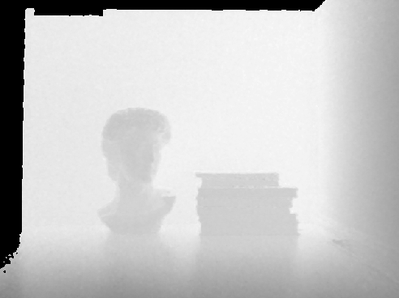

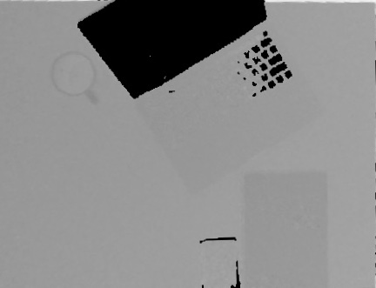
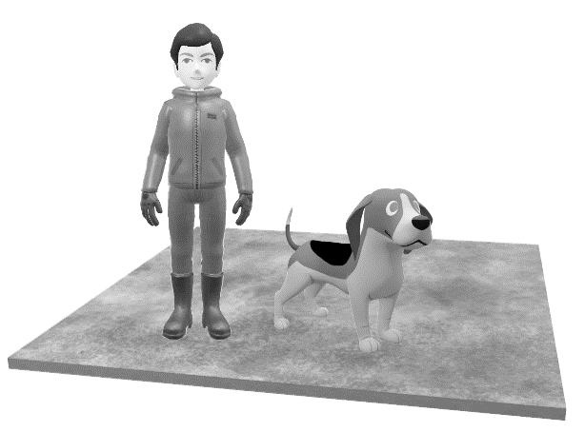

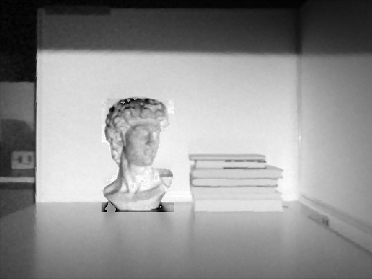
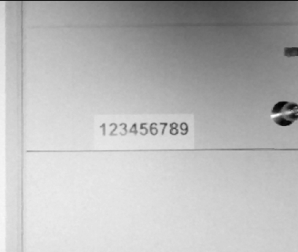
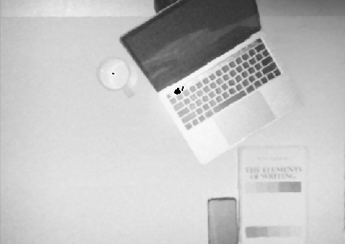
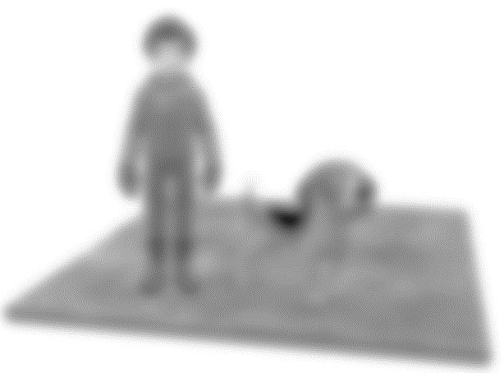
UltraDepth: System Overview
Distorting IR Source
iToF Depth Camera
UltraDepth Map
Ordinary Depth Map
UltraDepth is designed to expose high-resolution texture from the depth maps
UltraDepth is realized by introducing distorting IR source
Notes:
Based on this idea, we build the first practical system to expose texture from ToF depth maps.
For ordinary depth camera, we will obtain blurry and texture-less depth map. By introducing distorting IR source, we upgrade the ToF depth camera to an UltraDepth system which can expose high-resolution texture from the depth maps.
(可以和RGB做个对比，然后再讲我们是第一个practical system来expose texture
Our goal: research objective is to expose high resolution texture like this, with this capability.
Overview too early.
At the end of this, now I will give you the basic idea of how to achieve this.)

Slide 5
UltraDepth: Applications
Ordinary depth map
UltraDepth map
Augment depth-based applications
Launch privacy attacks to ToF cameras
Notes:
For example, as the pictures in the middle shows, through Ultradepth, we can clearly see the digits using a depth camera, while the ordinary depth map shows nothing.
With this capability, first we can augment depth-based applications, because we provide texture and more details from ordinary depth camera.
More importantly, this can raise some privacy concerns and can be used to launch attacks. For example, ultradepth can reveal personal identity in surveillance system which is considered impossible before.
(First, here we can see the maps from ordinary depth camera,
from our system, we can see that ultradepth map can show more details
With this capability, first we can augment xxx, because we provide texture and more details from ordinary depth camera.
More importantly, this can raise some privacy concerns and can be used to launch attacks. For example, xxxxxx)

Slide 6
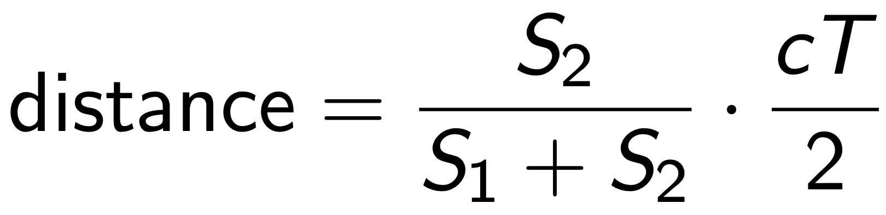
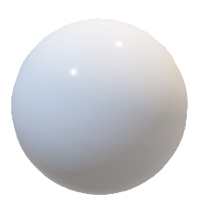
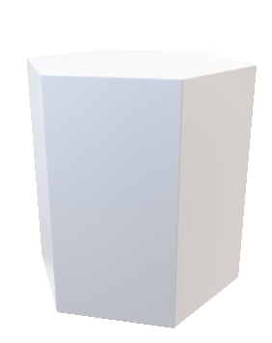
UltraDepth: Background
Depth map
Emitted light
T
Reflected light
S₁
Emitter
S₂
Camera lens
Phase shift
Notes:
If you want to know more about how UltraDepth works, let's first take a look at the basic principles of iToF depth cameras:
A ToF depth camera emits IR light, illuminates the scene to be captured and receives the IR light reflected by the objects in the scene.
The reflected light and emitted light have a phase shift due to the round trip time-of-flight of the IR signal between the scene and the camera. To calculate the value of phase shift, we collect reflected light in two successive time windows, namely S1 and S2. Using the ratio of S1 and S2, we can obtain the phase shift, and then the distance of objects. The distances of all points in the scene constitute the entire depth map.

Slide 7
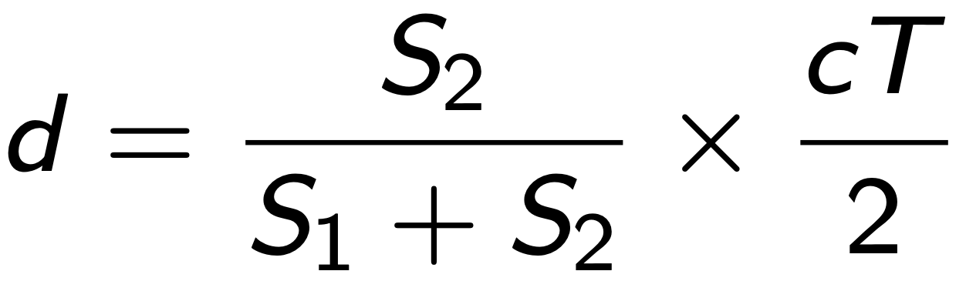
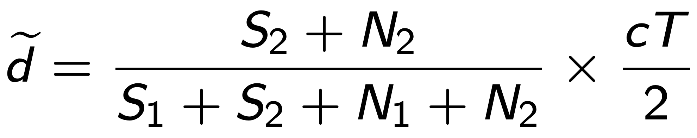
UltraDepth: Understanding Distance Measurement
Time
The real distance is:
T
Light Source
N₁
S₁
Window 1
t
T-t
The measured distance is:
N₂
S₂
Window 2
Light reflected by target objects
Light from distorting IR
Notes:
Now we have the formula to calculate the real distance d of objects in normal cases. However, the measured distance tilde d will be changed when the distorting IR source is present. Therefore, the formula contains N1 and N2, due to the interference of distorting IR.

Slide 8
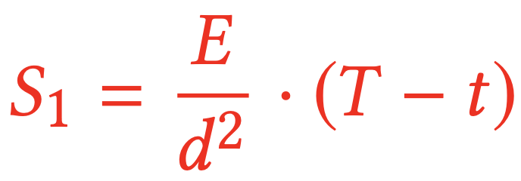
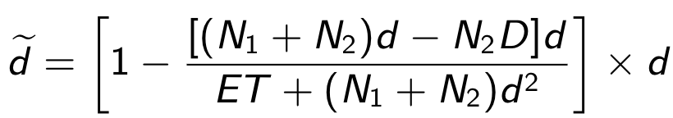
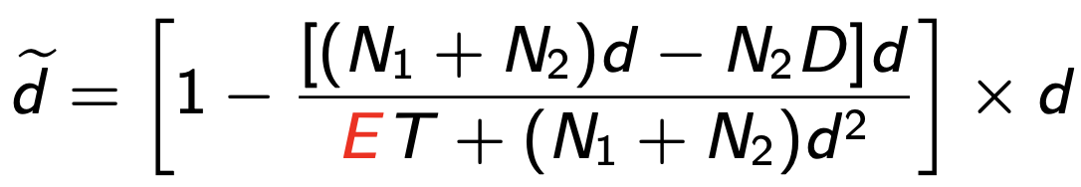
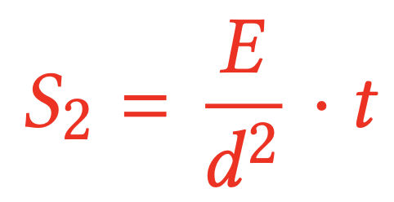
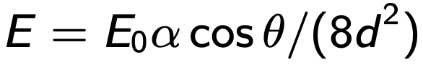
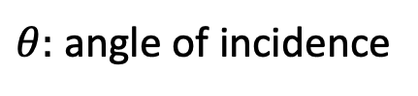
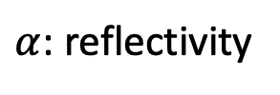
UltraDepth: Understanding Distance Measurement
The measured distance is:
: determines how distorted the distance measurement.
$α$: reflectivity
$θ:$ angle of incidence
Notes:
By substituting S1 and S2 and with rearrangement, we get a formula containing E to calculate the measured distance.
According to the Lambertian reflection model, E is determined by two key factors, namely reflectivity and the angle of incidence.
The physical meaning of E is the received IR intensity from an object at a unit distance.
It is obvious that E determines how distorted the distance measurement is.

Slide 9
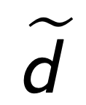
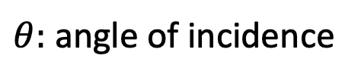
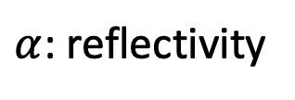
UltraDepth: Impact of Distorting IR
$α$: reflectivity
E
$θ:$ angle of incidence
Distance measurement
Texture-dependent
Expose
The distorted distance measurement exposes texture !!!
Notes:
Now, we can clearly see the chain of how the reflectivity and angle of incidence affect the depth measurement when introducing distorting IR. The reflectivity and angle of incidence of the object happen to be dependent on the texture. As a result, the distorted depth measurement can expose textures of the scene.
In short, our key message here is that the distorted measurement, actually can expose texture.

Slide 10
Two UltraDepth Implementations
Reflection-based Implementation
External IR-based Implementation
The distorting IR must have the same wavelength and modulation frequency as the ToF depth camera.
Notes:
Based on the in-depth analysis on distorting IR, we then propose two practical implementations of UltraDepth, which differ in how to construct a distorting IR source.
The key to impose an effective distortion on the depth map is to introduce distorting IR with the same wavelength and modulation frequency as the ToF depth camera. The most straightforward and convenient solution would be utilizing the IR light emitted by the depth camera itself.

Slide 11
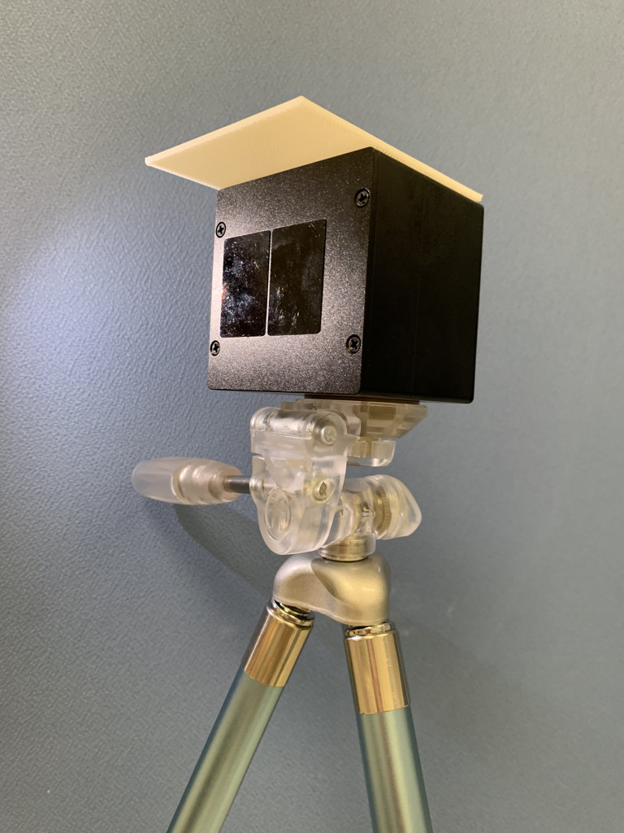
UltraDepth: Reflection-based Implementation
Cover board
Cover board
Part of the emitted IR is reflected by the cover board and serves as distorting IR.
Distorting IR
Emitter
Emitter
Lens
Common objects like walls, furniture can also work.
Notes:
The key to impose an effective distortion on the depth map is to introduce distorting IR with the same wavelength and modulation frequency as the ToF depth camera. The most straightforward and convenient solution would be utilizing the IR light emitted by the depth camera itself.
Based on this idea, we propose a reflection-based implementation of UltraDepth. We can simply use a cover board near the emitter to reflect part of the IR light emitted by the camera, and the reflected IR light serves as distorting IR.
In practice, we can easily realize this implementation since there are no special requirements on the cover board’s material. Even walls and furniture can be used in reflection-based UltraDepth.

Slide 12
UltraDepth: External IR-based Implementation
To use another ToF camera with the same model as distorting IR source.
Emitted IR
Objective: To align the emission time of the two cameras.
Distorting IR
Notes:
The external IR-based implementation, on the contrary, utilizes another ToF camera with the same model as distorting IR source.
However, a challenge is that the ToF camera does not emit IR light continuously, but only emits IR light of about 8ms in each period of about 33ms. Therefore, in order to implement an external IR-based UltraDepth, we need to align the emission time of the two cameras.

Slide 13
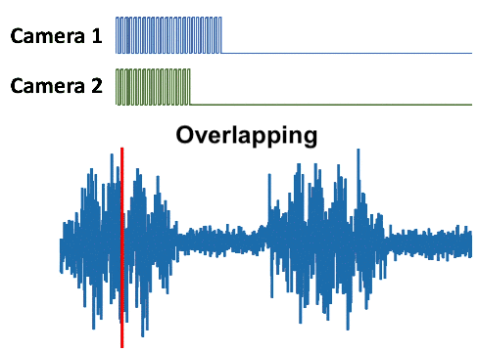
UltraDepth: External IR-based Implementation (Cont.)
Observation: Emission time of different cameras are slightly different.
We only need to adjust attacker’s emission time periodically for alignment.
The received signal fluctuates periodically
Notes:
We also observe that the emission periods of different cameras are slightly different, which leads to periodic overlap between two cameras.
When the emission time of the two cameras are overlapping, the received signal of both cameras fluctuates drastically, and vice versa.
From the view of the attacking camera, the received signal fluctuates periodically.
The attacking camera then learns when the two cameras are overlapping and adjust its emission time accordingly.

Slide 14
Experiments: Feasibility Study
Reflection-based UltraDepth
External IR-based UltraDepth
Notes:
For the experiment, we first validate the feasibility of both implementations of UltraDepth. The results show that reflection-based UltraDepth is quite easy to be implemented. Walls and desks work well to construct distorting IR and output good ultradepth maps. Also, the external IR-based UltraDepth is robust to the position of the IR source. For example, in the setup shown here, we place the distorted IR source in different location, all the locations will lead to relatively good ultradepth output.

Slide 15
Experiments: The Impact of Key Factors
Level of texture exposure in various scenarios
H_{glcm} : The metric to measure the level of exposed textures, which is calculated by the entropy of the gray level co-occurrence matrix (GLCM).
Notes:
Then, we study the impact of several key factors in UltraDepth design, including the size of the cover board, the distance between the objects and the ToF camera, and the modulation frequency of the ToF camera.
We define a metric Hglcm to measure the level of exposed textures.
As the left-hand side figure shows, a larger cover board will always lead to better performance as more IR light are reflected back to the camera; the middle figure shows the performance will decrease with larger distance due to the reduced object pixels; and the right-hand side figure shows that for an object at a certain distance, there exists a best modulation frequency that leads to the best performance.

Slide 16
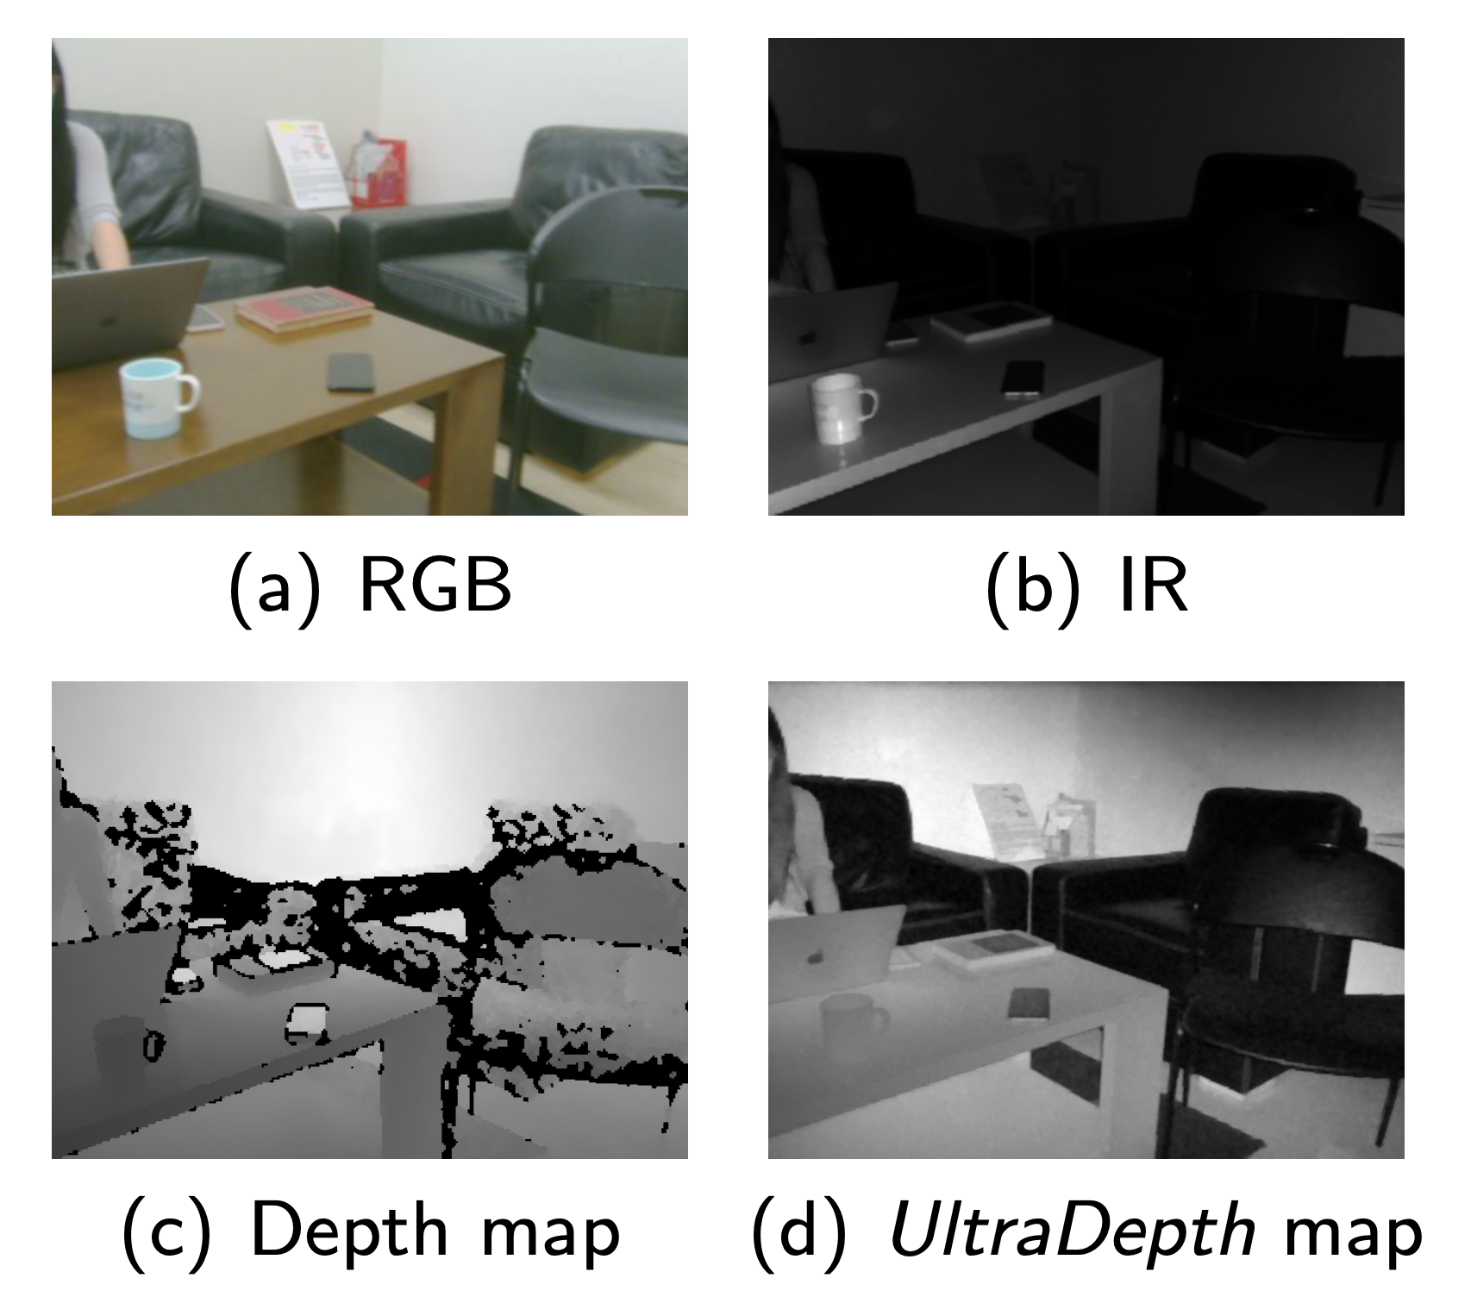
Experiments: Object Detection
Comparison between RGB, IR, Depth map and UltraDepth
The performance of UltraDepth is close to RGB and IR images, and far exceeds depth maps.
Notes:
We then evaluate the performance of ultradepth in object detection, where RGB, IR, ToF camera and UltraDepth are packed together to record the same scene for the object detection task.
For a fair comparison, we first convert the four types of images to 8-bit gray-scale images, and then we apply a widely used object detector YOLOv3 on these images.
With UltraDepth, the detection accuracy is much higher than the ordinary depth camera, moreover, we can recognize objects as accurately as RGB and IR images,

Slide 17
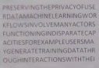
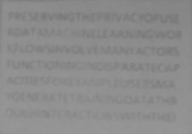
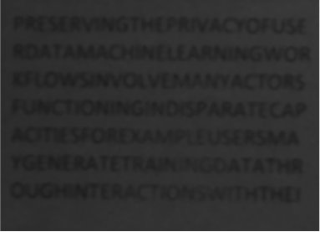
Experiments: Character & Face Recognition
Character recognition
Face recognition
RGB
UltraDepth
IR
UltraDepth
RGB
Features of 10 volunteers from UltraDepth are well clustered.
UltraDepth achieves 99.334% accuracy of classification
UltraDepth outperforms IR images.
Notes:
We then evaluate the effectiveness of UltraDepth in exposing text information. The examples of the captured images are shown here, from which we observe that the UltraDepth maps can well expose recognizable text information on the paper.
The average accuracy shows that UltraDepth outperforms IR images. More importantly, UltraDepth can even compete with RGB images under poor illumination.
To evaluate the effectiveness of UltraDepth for face recognition, we recruit 10 volunteers and record their faces with RGB camera, ordinary depth camera and UltraDepth camera.
A pre-trained RetinaFace detector is applied. It turns out no face can be detected for regular depth maps, while the face detection rate for UltraDepth maps are over 99%. From the heatmaps shown above, we can see that features of 10 volunteers from UltraDepth are well clustered. Moreover, UltraDepth achieves over 99% accuracy of classification which is comparable with RGB images.
A key takeaway from this result is that, depth images are not considered to preserve privacy anymore because our technology can reveal a lot of details such as characters and faces.

Slide 18
Conclusion
UltraDepth: The first practical system to expose high-resolution texture from depth cameras.
Provide in-depth analysis on the texture exposure mechanism of depth cameras.
Propose two practical implementations for UltraDepth.
Future work
Propose software-based UltraDepth to precisely control the texture exposure.
Provide robust defense against UltraDepth.
Notes:
In conclusion, we propose UltraDepth, the first practical system that can expose high-resolution texture from depth cameras.
We not only provided in-depth analysis on the texture exposure mechanism of depth cameras, but also proposed two practical implementations for UltraDepth based on the analysis.
Our future work will be in two directions:
First, we will implement software-defined UltraDepth to precisely control the texture exposure.
Moreover, we will investigate robust defense measures against UltraDepth-based privacy attacks.

Slide 19

Thanks!
UltraDepth: Exposing High-resolution Texture from Depth Cameras
Zhiyuan Xie, Xiaomin Ouyang, Xiaoming Liu, and Guoliang Xing
http://aiot.ie.cuhk.edu.hk
Visit CUHK AIoT Lab
Notes:
Thanks for listening. For more information, please refer to our paper and our lab website.

